Slide 1
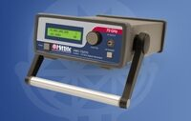
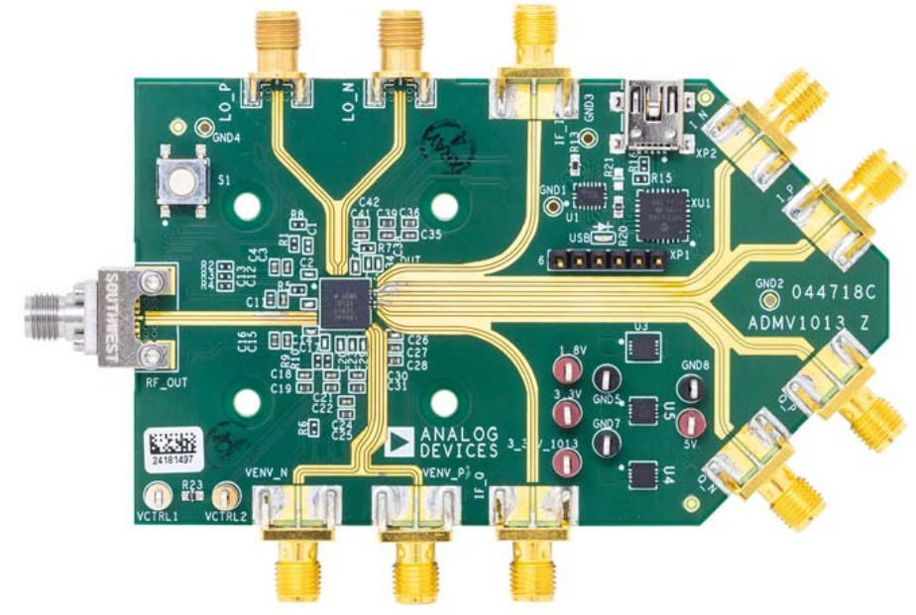
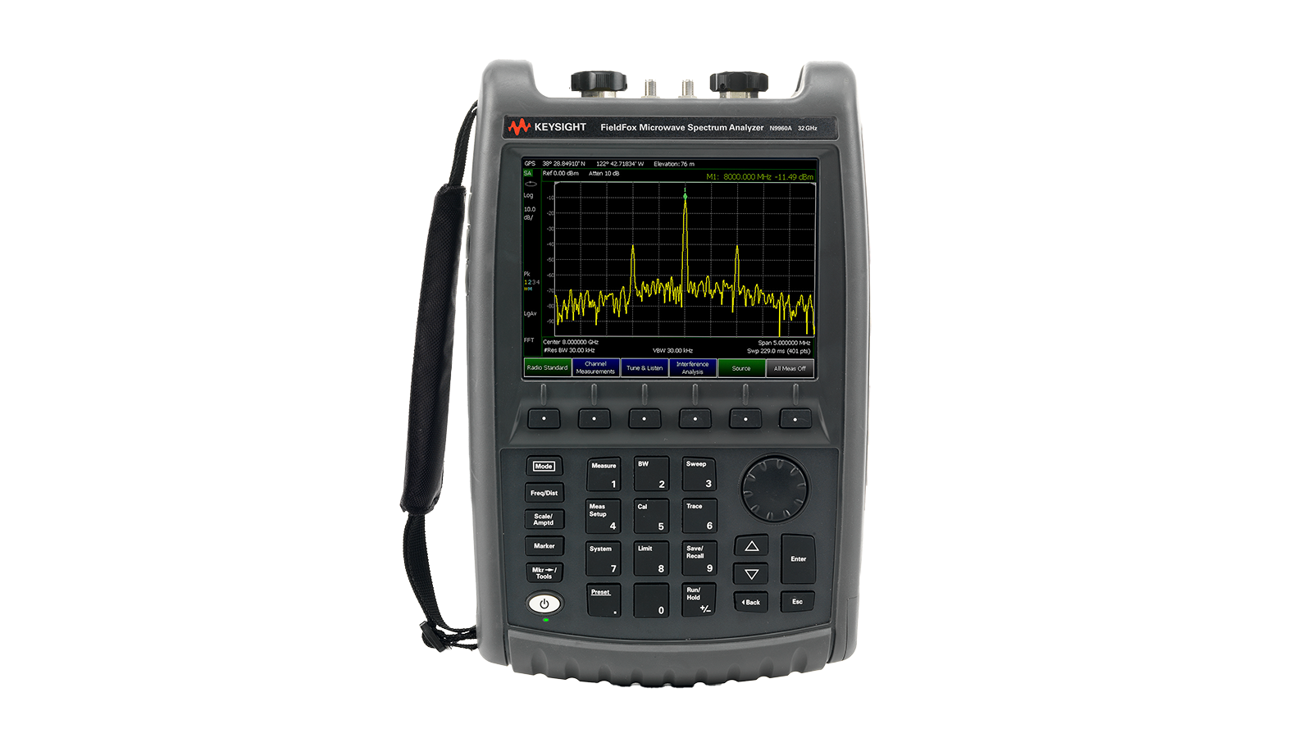
ADMV1013s
GPIB 12
To PXIe
IN
BAL0010
0° 180 °
GPIB 27
IN
1
90° splitter
2

Slide 2
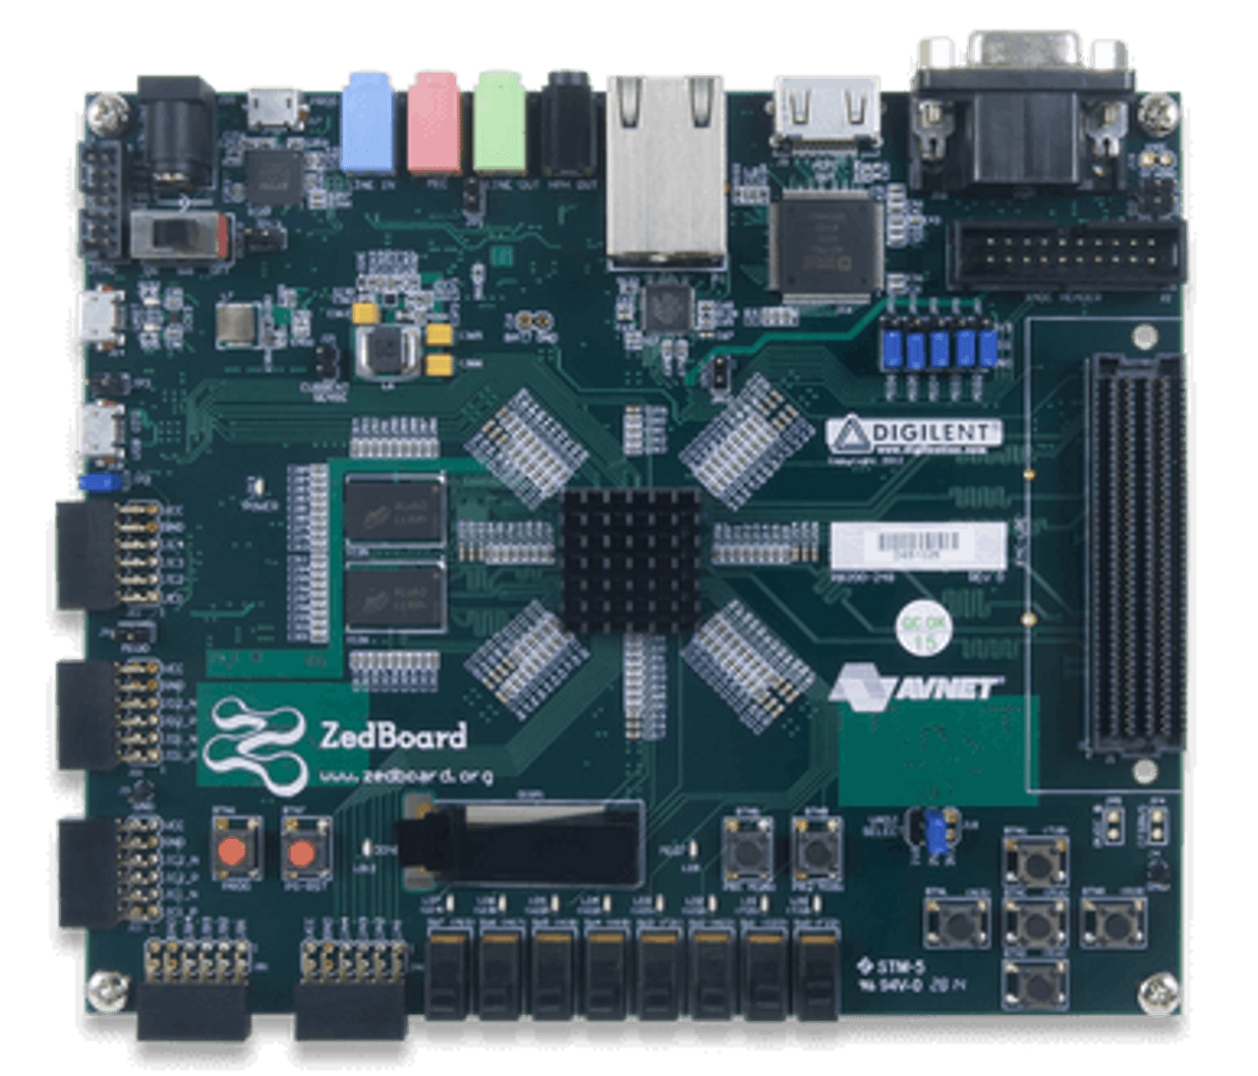
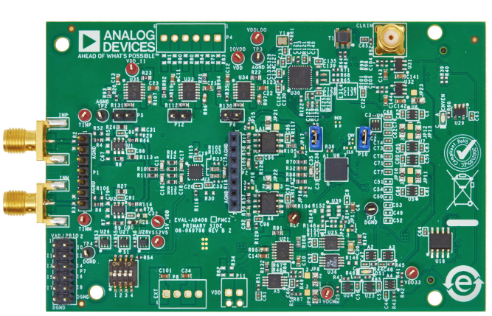
To PC
DC Power
GPIB 12
BAL0010
in

Slide 3
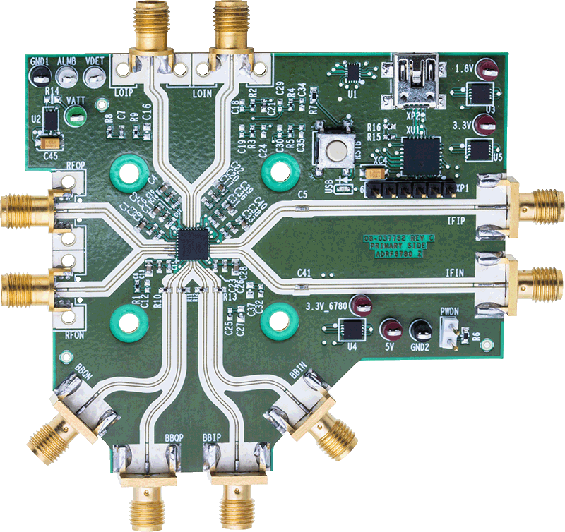
Hittite 1
BAL0212
IN
OUT1
OUT2
Hittite 0
USB To PC
BAL0520
OUT1
0˚
IN
IN
BAL0010
OUT2
180˚

